Slide 1




EXCELSSIOR EDUCATION SOCIETY’S K. C. COLLEGE OF ENGINEERING AND MANAGEMENT STUDIES AND RESEARCH (Affiliated to the University of Mumbai) Mith Bunder Road, Near Hume Pipe, Kopari, Thane(E)-400603
Department of Information Technology
Academic Year 2023-24(Even Semester)

Slide 2
MAJOR PROJECT
PRESENTATION
SEM VIII (2023-2024)

Slide 3
VR Horror Game
Group members
1) Ritvik Babre - 05
2) Hitesh Behera - 06
3) Shruti Sabbani - 50
4) Swapnil Yadav - 67
Guide Name: Asst. Prof. Punam Bagul

Slide 4
Index
Introduction
Need
Problem Statement
Literature survey
Algorithm
Architecture
Flow-chart
Requirements
Feasibility Study
Proposed Methodology
DFD Diagram
Implementation Details
References

Slide 5
Vision
To create IT graduates with ethical and employable skills.
Mission
To imbibe problem solving and analytical skills through teaching learning process.
To impart technical and managerial skills to meet the industry requirement.
To encourage ethical and value based education.

Slide 6
Introduction
Virtual reality (VR) horror games offer an unparalleled immersion by leveraging first-person perspective, realistic graphics, and interactive gameplay. Players experience the game world through the eyes of the protagonist, enhancing the feeling of presence and intensifying the horror experience. Detailed environments, coupled with atmospheric lighting, create a sense of dread, while interactivity allows players to manipulate objects and solve puzzles. Jump scares are effectively utilized to startle players, taking advantage of the heightened sense of immersion in VR. Compelling narratives further engage players, drawing them deeper into the terrifying world of VR horror gaming.
VR Horror
Immersion
Promote VR

Slide 7
Need
Developing a VR horror game serves a dual purpose: promoting both VR technology and the horror genre, strategically targeting a diverse audience. VR technology offers an unparalleled level of immersion, transporting players into terrifying realms in a way that traditional gaming platforms cannot match. horror as a genre possesses broad appeal, VR horror game can attract both avid horror enthusiasts and newcomers, thereby expanding the reach of VR gaming. VR horror game serves as a potent demonstration of VR technology's capabilities. By showcasing how VR can deliver intense, immersive experiences that evoke strong emotional responses, this project effectively promotes VR to a wider audience, driving interest and adoption of the technology.

Slide 8
Why opted for Horror Genre ?
Horror genre consistently rank highly across demographics and gaming platforms, showcasing their widespread appeal and engagement. Horror games excel in delivering an immersive experience that truly transports users to another world, creating a sense of fear and suspense that showcases VR's capabilities effectively. The use of spatial audio further enhances this sense of immersion, drawing players deeper into the game environment. In India, where horror stories and supernatural themes hold cultural significance, VR horror games have the potential to resonate strongly with audiences across all demographics who are enthusiastic consumers of horror content. By leveraging the universal appeal and emotional impact of horror games, VR technology can be effectively promoted and embraced as a powerful medium for immersive experiences and storytelling in the future.
Widespread Appeal
Powerful
Medium
Thrill &
Adrenaline

Slide 9
Problem Statement
Virtual reality (VR) is an emerging technology that has the potential to revolutionize the way we interact with games and other experiences. However, VR is still relatively new and expensive, and many people lack the understanding of how it works. This limits the reach of VR technology and prevents it from becoming an integral part of our lives.
One way to introduce VR technology to a wider audience is to develop VR games. Gaming being one of the biggest industries in the world will allow VR to get a platform where it can showcase its endless possibilities to the world. Horror Games are some of the biggest games in the industry as they allow the player to get immersed with the environment. This makes the horror genre one of the best genres to showcase the capability of VR.
Expensive
Technical Constraints
Awareness
& Education

Slide 10
Literature Survey
Sr. No. | Title | Authors | Methodology | Advantages | Results
1 | Virtual Reality Horror Games and Fear in Gaming (2023) | Tammy Jin-Hsuan Lin | -Evolutionary mechanism, -Excitation transfer theory and model of suspense -Three-factor model | -Immersion in VR -Audience Experience -Valueable insights to human behaviour and emotions -Interactive Storytelling | -Deeper understanding of human behavior & media effects -Helps address various phobias
2 | Research on the Application of VR in Games (2023) | Shijie Bian | -Appliaction of VR in Horror, Role-Playing and Rhythmic games | -Strong sense of immersion -Realistic environments and gaming experience -Enhanced fun and entertainment | -Scope of VR -Future Gaming experience -Evolution of VR in Games
3 | Research on the Progress of VR in Game (2023) | Ruiqi Zhang | -Application in VR in Action Simulation, Education, Scenario experienced Games | -Enhanced gaming experience -Improved teaching -Enhanced Immersion | -Strong Game Immersion -Real time human- machine interaction -Analysis of trends and characteristics

Slide 11
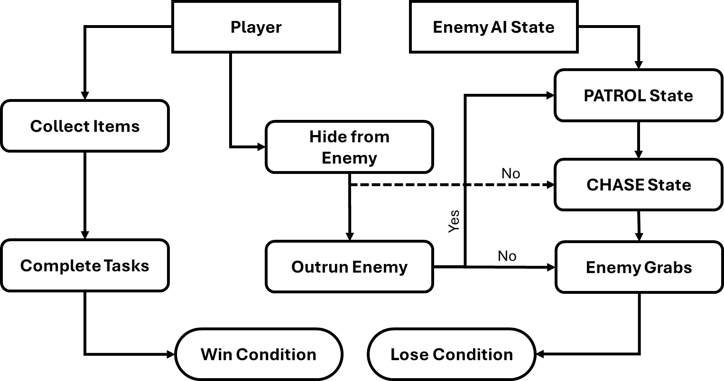
Algorithm

Slide 12
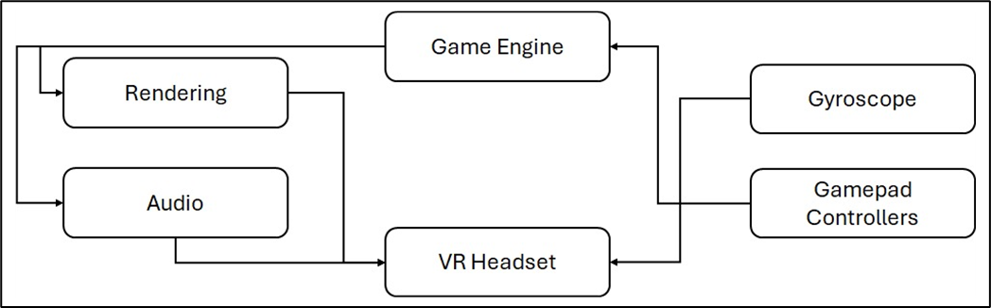
Architecture

Slide 13
Hardware & Software
Requirements
Hardware | Software
Android device | Google cardboard SDK
Gyroscope | Game Engine - Unity
Gamepad Controller | Version Control System - GitHub
VR Headset | Scripting Language – C#
 | IDE – Visual Studio

Slide 14
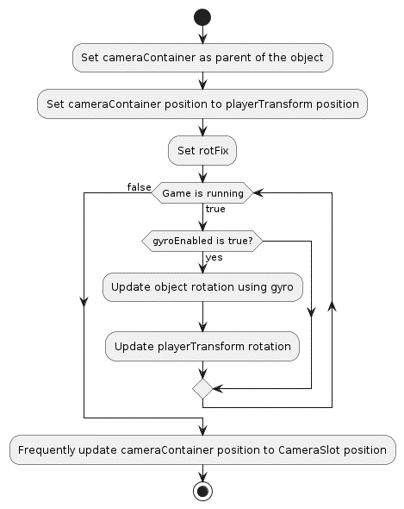
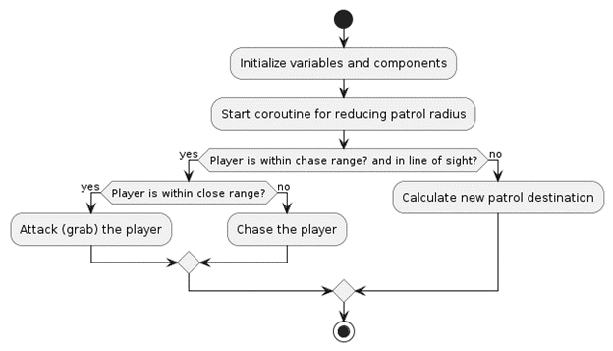
Flowchart

Slide 15
Feasibility Study
Market Analysis:
Demographics
Market Demand
Market Trends
Budget Power
Technical Feasibility:
High Computational Power
Rendering
Power Usage
Financial Feasibility:
Hardware Cost
Entry Cost
Spending Power
Legal Considerations:
Copyrights

Slide 16
Proposed Methodology
The VR horror game incorporates essential features to deliver an immersive experience. Player collects items crucial for progression while evading relentless AI Enemy, heightening the terror. Leveraging the Google Cardboard SDK, it offers immersive VR experiences on Android devices, aided by the Gyroscope tracking head movements. The Game Manager synchronizes elements for a cohesive experience, overseeing states, UI, and win-loss conditions. An Item Spawner algorithm enhances replay-ability by randomly placing items. Audio Management adds to the atmosphere with 3D spatial sounds. VR-friendly UI elements aid interaction. Victory entails completing tasks and escaping enemies, while failure comes with capture. Together, these elements create an intense and immersive horror game.

Slide 17
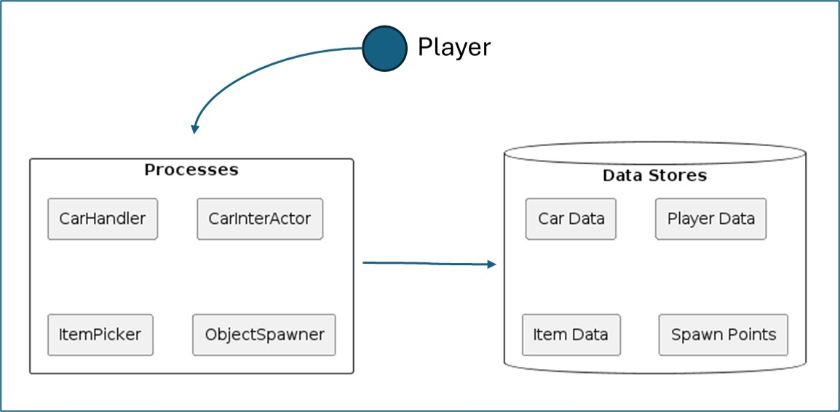
DFD Diagrams
DFD Level: 0

Slide 18
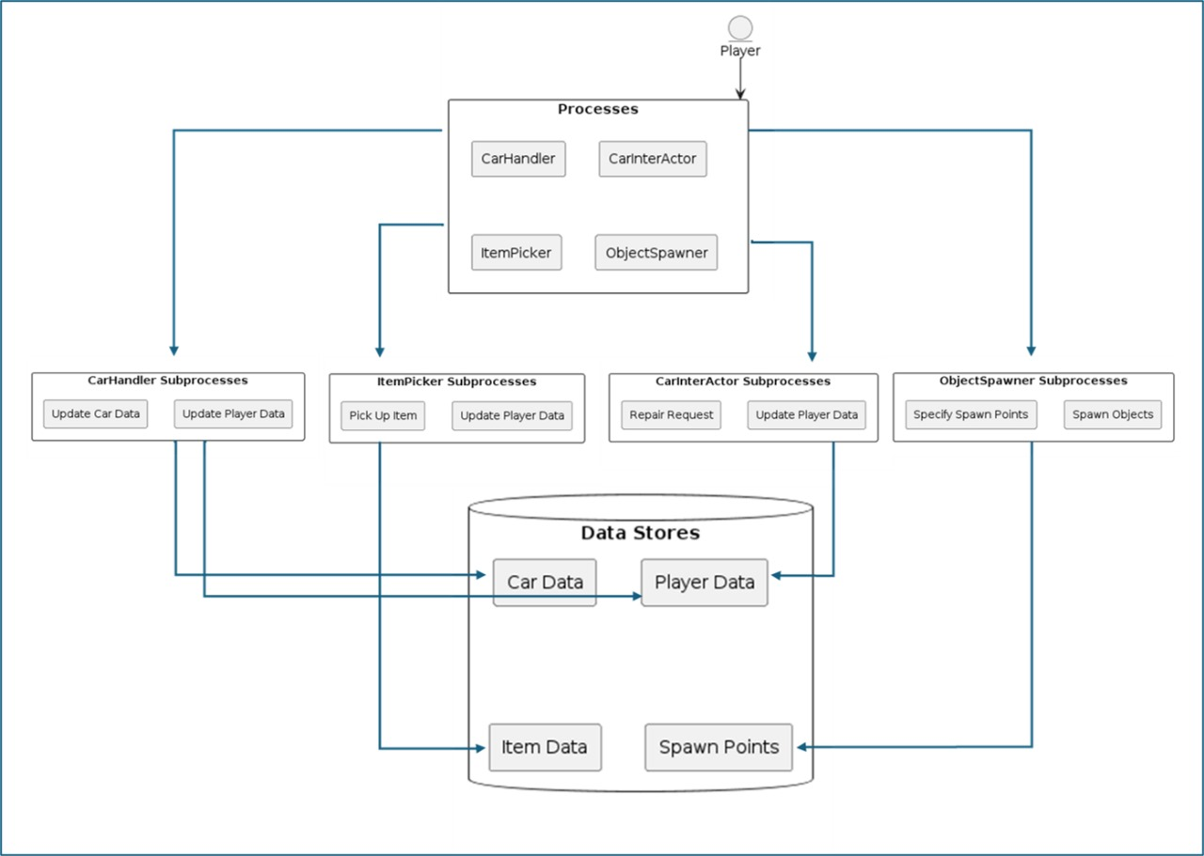
DFD Diagrams
DFD Level: 1

Slide 19
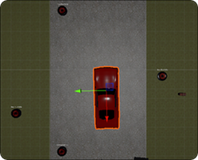
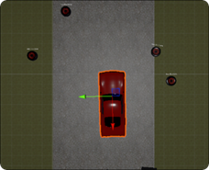

Implementation Details
Item spawn at Random Spots in every instance

Slide 20
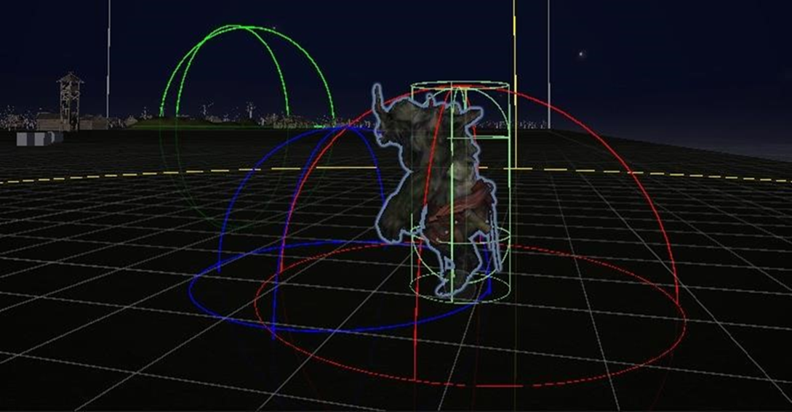
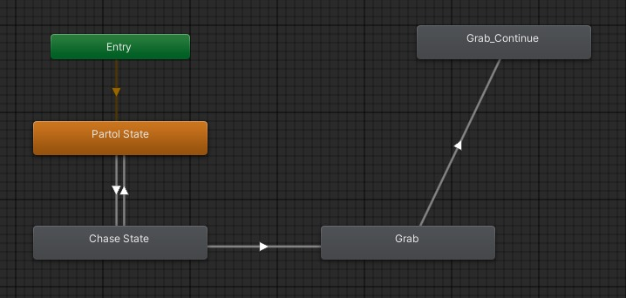
Implementation Details
Enemy in PATROL State
Enemy <Animator> Component
Wireframe spheres:
yellow : area within which the enemy will start chasing the player.
red : area within which the enemy will attempt to attack or grab the player.
green : area within which the enemy will patrol randomly when not chasing the player.
blue : area within which the enemy can grab the player if the player is close enough.

Slide 21
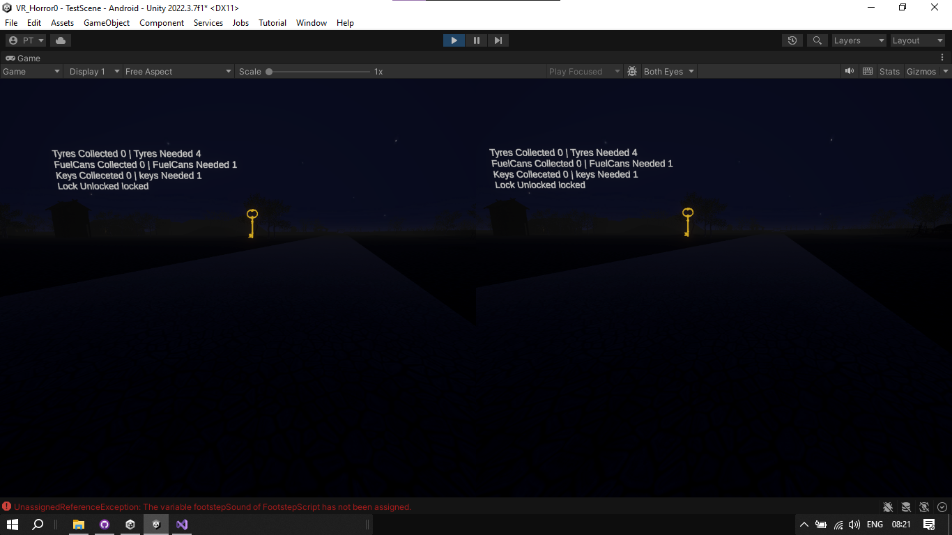
Implementation
Stereoscopic view
with MockHMD in Unity

Slide 22

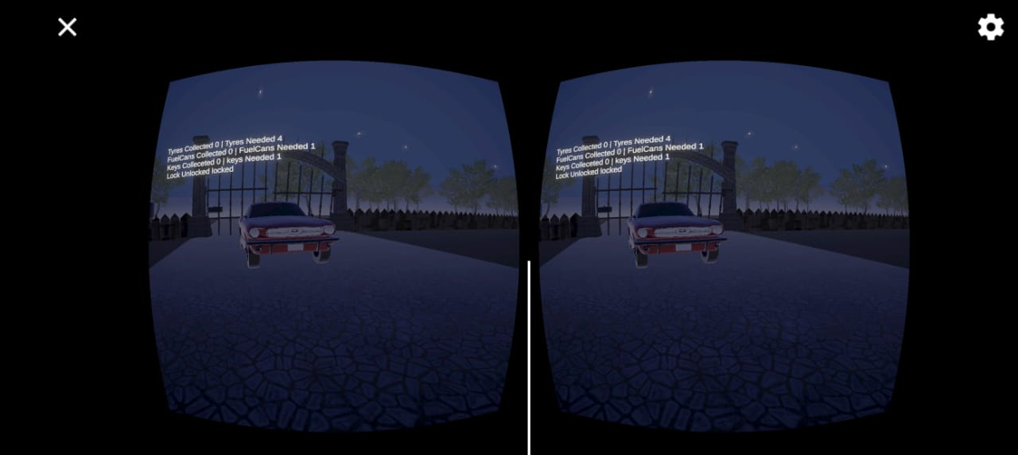
Implementation
Stereoscopic view achieved with
Google Cardboard in Android device

Slide 23


Slide 24


Slide 25
Conclusion
Our VR horror game incorporates a holistic approach to gaming, seamlessly blending immersive environments with advanced technology while catering to the traditional enthusiasm for consuming horror stories. It represents a fusion of past, present, and future elements, presenting VR seamlessly into daily life experiences. Adhering to VR rules and integrating cohesive features, our game sets a new standard for immersive entertainment.
Introducing
Interactive Computing
Integration into
day-to-day life
Blending
past-present-future

Slide 26
References
Ntokos, Konstantinos. "Level of fear”: Analysis of fear spectrum into a tool to support horror game design for immersion and fear." An International Journal (CGDEIJ) 1, no. 33-43 (2018).
Årnell, Tobias, and Nikola Stojanovic. "Horror game design–what instills fear in the player?: A study on the effects of horror game design theories and level design patterns on player behaviour in a horror environment." (2020).
Zhang, Ziwen. "Analysis of the design aesthetics and player emotions of horror games: Take ‘Little Nightmares’ as a case." (2022).
de Lima, Edirlei Soares, Bruno MC Silva, and Gabriel Teixeira Galam. "Adaptive virtual reality horror games based on Machine learning and player modeling." Entertainment Computing 43 (2022): 100515.
Lin, Jih-Hsuan Tammy, Dai-Yun Wu, and Chen-Chao Tao. "So scary, yet so fun: The role of self-efficacy in enjoyment of a virtual reality horror game." New Media & Society 20, no. 9 (2018): 3223-3242.
Lin, Tammy Jin-Hsuan. "Virtual Reality Horror Games and Fear in Gaming." In Oxford Research Encyclopaedia of Communication. 2023.
Bian, Shijie. "Research on the Application of VR in Games." Highlights in Science, Engineering and Technology 39 (2023): 389-394.
Zhang, Ruiqi. "Research on the Progress of VR in Game." Highlights in Science, Engineering and Technology 39 (2023): 103-110.

Slide 27
Thank You!!!

